Slide 1
Introduction to Problem Solving
Dr. Desmond Moru
Dr. Kazeem Oyebode

Slide 2
Course Objectives
To understand how problems are formulated by means of algorithms
How the process of abstraction can be used to break problems down to easily manageable pieces.
Apply the knowledge of developing algorithm to practical real world problems.

Slide 3
Course Outline
Role of Algorithms in problem solving process
Concepts and properties of Algorithms
Implementation strategies
Development of Flow Charts, Pseudo Codes.
Implementation of Algorithms in a programming Language - Python

Slide 4
Problem Solving with Python
Jupyter Notebooks Magic Command
Data Types and Variables
NumPy and Arrays
Functions and Modules
If Else Try Except
Loops
Plotting with Matplotlib

Slide 5
Course Outline
Object Orientation Programming
Class, Object
Method
Inheritance, Encapsulation
Polymorphism, Data Abstraction

Slide 6
Required Texts
1
Problem Solving with Python 3.7 Edition: by Peter D. Kazarinoff
2
Python 3 Object Oriented Programming: by Dusty Phillips
3
A Pratical Introduction to Python Programming: by Brian Henoid
4
Python 3 for Absolute Beginners: by Tim Hall and J-P Stacey

Slide 7


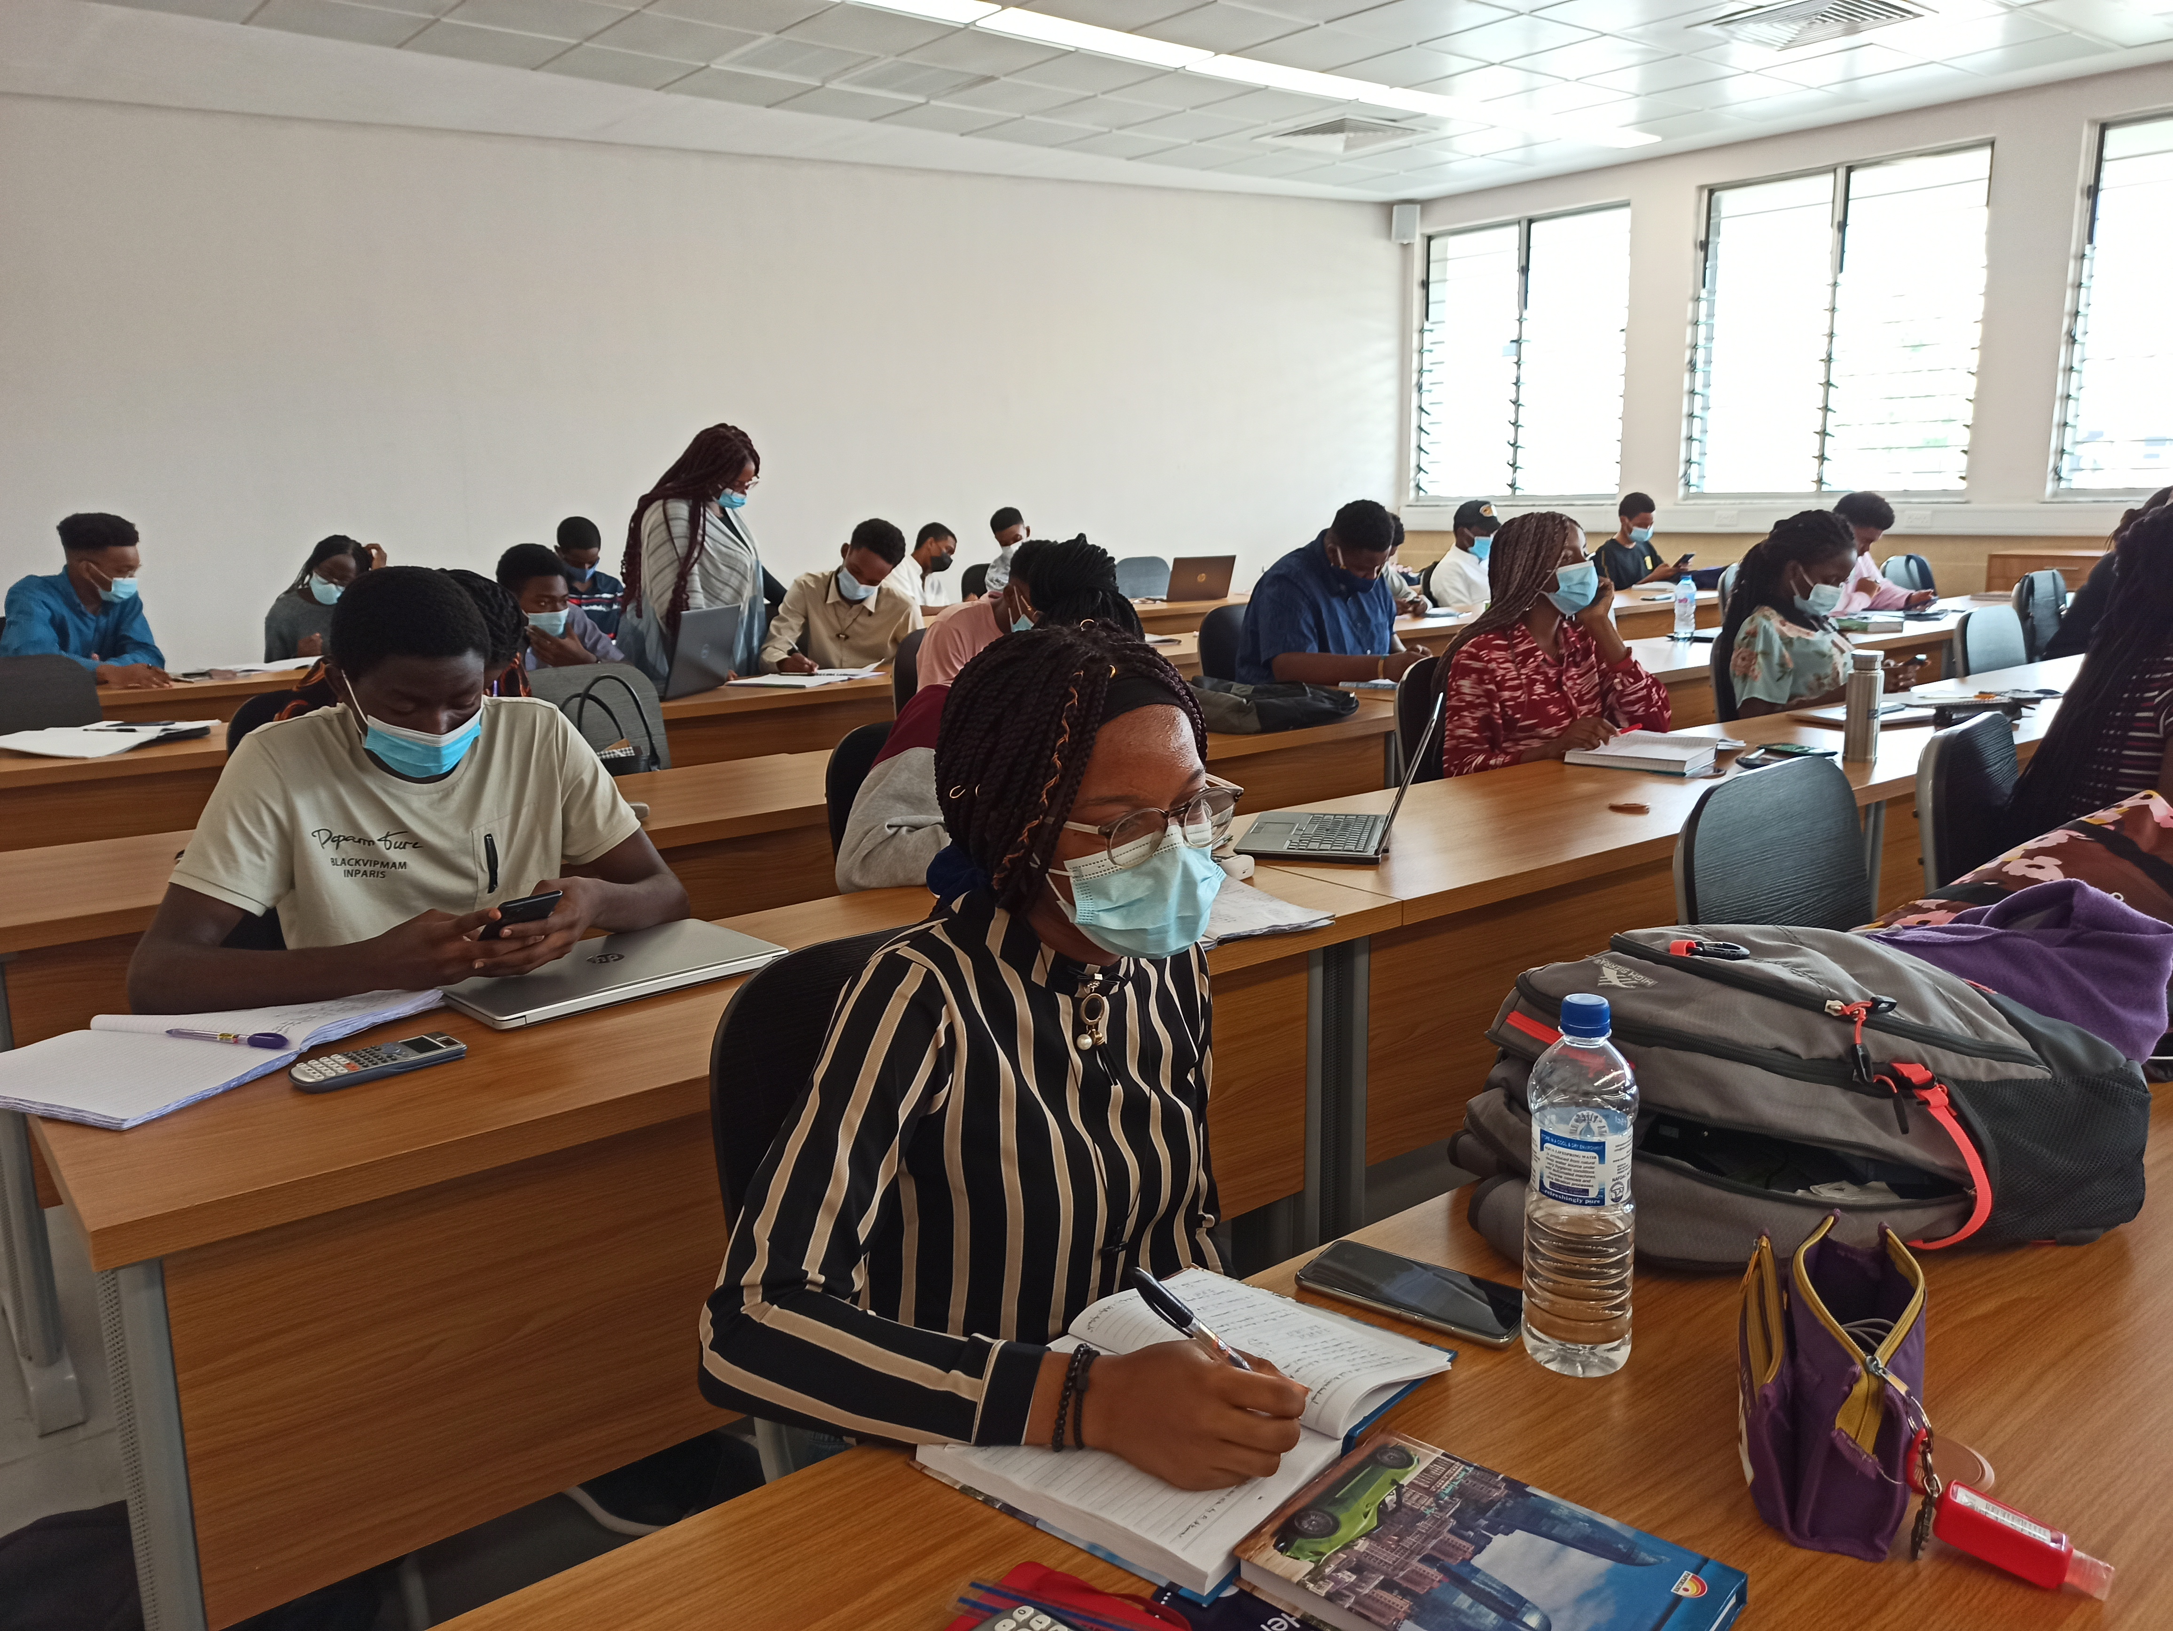

GitHub
A provider of Internet hosting for software development and version control using Git.
It offers the distributed version control and source code management (SCM) functionality of Git, plus its own features
It provides access control and several collaboration features such as bug tracking, feature requests, task management and continuous integration for every project.

Slide 8
Git?
a
Git is software for tracking changes in any set of files.
b
Used for coordinating work among programmers collaboratively developing source code during software development.
c
Its goals include speed, data integrity, and support for distributed, non-linear workflows (thousands of parallel branches running on different systems).

Slide 9

GitHub
Practical Lab

Slide 10
Steps to signup for GitHub
goto: https://github.com
Signup for GitHub
Create your Account
Create Repo Name: dmoru883/desmondCSC102
Sede CMD Line to Document
Clone Repo: git clone <https…>
Commit Repo: git commit –m”Message”
Push Repo: git push

